Slide 1

Book My Movie.com Project

Slide 2
Introduction
We enjoy going to the movies.But do you know how do you virtually select a Ticket and book it. How does it not show the seats which are booked? How does it cut cost according to certain scenarios for certain seats and rows?
It would be interesting to mimic that. Isn’t it?
Let’s do it!!

Slide 3
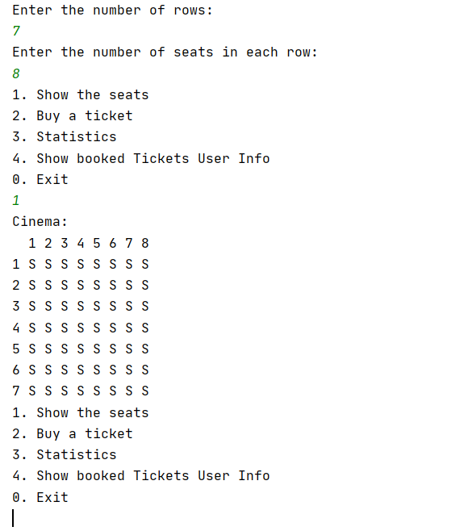
Objective: Interaction
When I run the main.py file of your Program. It should show me this kind of interaction.
Ask the number of rows and seats per row and than show these 4 options until I choose Exit:
1.Show the seats
2. Buy a Ticket
3. Statistics
4. Show booked Tickets User Info
0. Exit
Output of the Program

Slide 4
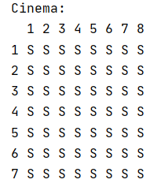
1.Show the seats
A cinema Hall with 7 Rows and 8 seats per Row should look like this.
Notice that S shows the Vacant Seat here and the counting in the beginning of the row and column is just for reference to the seat number.
ALL SEATS VACANT

Slide 5
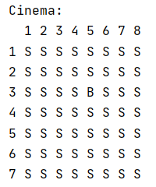
1.Show the seats (contd.)
Reserved seat will show a B. Like here Seat at (Row No 3 ,Column 5th) is Booked.
Hint: Use nested for loops to show the cinema like this.
3RD ROW,5TH COL BOOKED

Slide 6
2.Buy a Ticket
When I buy a Ticket It should ask me row number and column number for the ticket I am booking.On the basis of the Rules it should show me the Price for that seat and ask If I want to book.
If I choose Yes, it should take details of Name,Gender,Age and Phone No.
Think about a data structure where you can save it(list ? set? Or a dict?)
Finally It should print Booked Successfully.

Slide 7
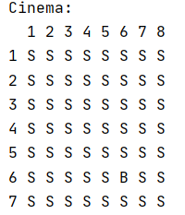
3. Statistics
When I choose the 3rd option for statistics.
It should show me the following things:-
Number of Purchased Tickets
Percentage of Tickets booked
Current Income
Total Income
(Please follow the rules for calculating price for each seat as shown in the next slide)
Number of purchased tickets: 1
Percentage: 1.79%
Current income: $10
Total income: $560

Slide 8
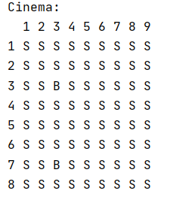
The ticket price is determined by the following rules:
If the total number of seats in the screen room is not more than 60, then the price of each ticket is 10 dollars.
In a larger room, the tickets are 10 dollars for the front half of the rows and 8 dollars for the back half. Please note that the number of rows can be odd, for example, 9 rows. In this case, the first half is the first 4 rows, and the second half is the rest 5 rows.
Number of purchased tickets: 2
Percentage: 2.78%
Current income: $18
Total income: $648

Slide 9
4. Show booked Tickets User Info
When I choose the 4th option:
It should ask me the row and col number.
If that row,col is booked show the Name,gender,age,Ticket Price and Phone No
Name: Ranjit
Gender: Male
Age: 23
Ticket Price: 8$
Phone No: 1234567891

Slide 10
Expected Results.
The whole code should be modular by using proper classes and functions.
Using of OOP is compulsory

Slide 11
ALL THE BEST

